Slide 1
Water Supply and Demand
Professor Richard T. Carson
Department of Economics
University of California, San Diego

Slide 2
USA Today Headline Calif. facing worst drought in modern history
Snow pack on Sierra Nevada Mountains 61% of normal
49% northern, 63% central ,68% southern parts
Two largest reservoirs at less than half capacity
Shasta and Oroville
Weather pattern (La Nina) likely to drop water outside of California this year
Court order to leave water in rivers to protect fish
State of California announces likely to only deliver 15% of contracted water to urban areas and agriculture
Bureau of Reclamation to make similar announcement

Slide 3
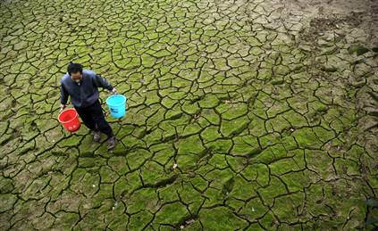
MSNBC Headline
China drought leaves 4 million without water
Government declares emergency as millions of acres of crops wither
Worst drought in Henan Province since 1951

Slide 4
Key Elements of Modern Water Supply
Stochastic
Snowfall on Sierra Nevada Mountains stochastic
More subtle but important, somewhat predicable/not iid
Usage in single year not limited to precipitation
Reservoir storage
Multiple sources
State & Federal projects
Not stated in story: local supplies/groundwater
Contracts to deliver water
Legal/environmental constraints

Slide 5
Simple Case for Farmer
Own farm and a groundwater well
Aquifer size
Recharge rate
Pumping cost
Have a farm where crops grows better with irrigation
Yield as a function of inputs
Crop gets some natural precipitation

Slide 6
Decisions
How much land to plant
What crops to plant
Price expectations and responsiveness to water
How much land to allocate to each crop
How much groundwater to use in different time periods
How much to rely on precipitation
Changes in behavior when it rains
Development of expectations about future rain
Simplify the decision making process
Only one crop available and all land planted
Dryland agriculture assumption with fertile land, enough rain and price support. Planting cost, fertilizer use, pesticides not related to water.
One time period for water (right before planting)/rainfall known

Slide 7
Maximization Problem
Pump groundwater to maximize present value of discounted profits from growing crop
Decide how much water to put on at planting
Immediately after observing rainfall

Slide 8
Three Parts of the Water Cost Function
Total
Cost
Quantity of Water

Slide 9
Three Parts of the Water Cost Function
Marginal
Cost
Quantity of Water
Free Rain Constant Cost Pumping Pumping Cost +
Aquifer Recharges Overdrafting

Slide 10
Marginal Cost Curve Shifts With Changes in Stochastic Rainfall
Marginal
Cost
Quantity of Water
Free Rain Constant Cost Pumping Pumping Cost +
Aquifer Recharges Overdrafting

Slide 11
Other Pumping Cost Considerations
Rainfall
Cost can be increasing if need to direct/store water
Groundwater pumping less than recharge rate
Cost can be increasing if pumping cost go up as water table drops
Groundwater pumping greater than recharge rate
Can be approximately equal to pumping cost if
Aquifer is large enough
Neighbor will pump the water if you don’t
Reason: stored water yields no resource rents

Slide 12
No Groundwater Pumping with Enough Rain
Marginal
Cost Demand
for Water
Quantity of Water
Free Rain Constant Cost Pumping Pumping Cost +
Aquifer Recharges Overdrafting

Slide 13
More Realistic Uncertainty
Our simple setup of observe rain, decided on groundwater eliminates important role of uncertainty
Major impact of uncertainty is on planting decision
If normal rainfall, planting crop is profitable
If less than normal, planting crop looses money
Major issue in many developing countries
With irrigated agriculture uncertainty can enter into decisions in many ways
Use groundwater now at optimal (physical) application time or wait for free rain at somewhat less optimal time
Substitution of other inputs such for water depends on water cost
What is the recharge rate of the aquifer?

Slide 14
Basic Setup for Water Demand
Competitive firm (agriculture/industry)
With shift from profit to utility and a household production function also works for consumers
Output y, inputs x1, …, xi…, xk, and water w.
Price of output, p, price of inputs m_{i}
Production function
y = f(x1, …, xi, …, xk, w)
f(•) is continuous, twice differentiable in all inputs
First derivatives of f(•) with respect to all positive over relevant range with decreasing returns at some point

Slide 15
Production Function All Inputs Fixed at x* Except Water
y
_ _ _ _ Ymax _ _ _ _ _ _ _ _ _ _ _ _ _ _ _ _
w w

Slide 16
Marginal Production Function All Inputs Fixed at x* Except Water
y Increasing Decreasing
Returns Returns to Scale
y’ = ∂f/∂w
w w

Slide 17
Firm Profit Maximization
Max p · f(x, w) – mx – c(w), where x, m now vector notation
Profit maximization implies
p · ∂f/∂xi = mi

Slide 18
Firm Profit Maximization
Max p · f(x, w) – mx – c(w), where x, m now vector notation
Take first derivatives and set equal to zero
Profit maximization implies usual marginal conditions
p · ∂f/∂xi = mi
For water set marginal revenue product equal marginal cost
p · ∂f/∂w = dc/dw
Second order condition p · ∂²f/∂w² – d²c/dw² < 0 needs to hold
If water is mispriced it will be misused!

Slide 19
Water Demand Function
$ p·∂f/∂w
w w

Slide 20
Quadratic Production Function
Profit = p · (α1 + α2w – α3w²) – Ѳw
Assuming all other inputs fixed at some level
∂Profit/∂w = p · (α2 – 2α3w) –Ѳ = 0
-p·2α3w = Ѳ – α2p yields water demand:
w = (α2·p – Ѳ)/(2α3·p)
Now allow other inputs to vary yields water demand as:
w = (α1·α2^{α2}·α3^{(1-α2)}·Ѳ^{(α2-1)}·m^{-α2} ·p)^{[1/(1 -α2 –α3)]}

Slide 21
Utility Equivalent
Max U[x1, …, xi, …, xn, w]
Subject to c(w) + ∑_{i} mi ∙ xi = Income (I)
w = D[c(w), m1, …, mi, …, mn, I)
Can also constrain utility by rationing w so that w_{r} is less than w* that solve the demand equation above

Slide 22
Water Demand for a Household
Water
Price
p_{w}
w* Water Quantity

Slide 23
Oscar Burt 1964 Paper
General setup for groundwater (Burt’s notation used)
Works for many renewable resources
s = quantity of resource in stock or reserve
x = quantity of resource used from stock per period
w = exogenous addition of resource to stock per period
G(x, s) = expected net output per period
h(w, s) dw = probability density function for additions to stock
ω(s) = expectation of w for a given magnitude of s
β = (1 + r)⁻¹, where r is the periodic interest rate.

Slide 24
Let f(s) be the present value of net expected output
Load economics part into G(•)
Assume on optimal path where n represents time periods
Use Bellman principle of optimality to get
f_{n}(s) = Max _{x} [G(x, s) + β∫f_{n-1}(s + w -x)h(w, s) dw]
Now let n go to infinity, f_{n+1}(s) = f_{n}(s) = f(s) so
f(s) = Max _{x} [G(x, s) + β∫f(s + w -x)h(w, s) dw]
Standard difficulty cannot solve for f(s)
Assume specific functional forms
Assume G(x, s) same in all periods
Take numeric (Taylor-series) approximations
∂G(x, s)/∂x – βf’(s) = 0
With assumption w is independent of s:
∂G/∂x = (1/r) ∂G/∂s

Slide 25
Intuition
Burt (1964)
“Expand production to the point where marginal net output with respect to current consumption of the resource is equal to present value of a perpetual annuity equal in value to marginal net output with respect to quantity of resource in stock.”
Common to write contribution to out put as
G(x, s) = R(x) - c(s)x, where R(x) incremental value before taking account of pumping cost c(s)x
Relationship at optimal groundwater pumping is:
(R'(x) - c(s))/x = -c'(s)/r
“Production for the basin is expanded to the point where marginal net output per unit of water is equal to the negative of capitalized marginal pumping costs with respect to water in storage (c'(s) being negative).”
Right hand side is opportunity cost of pumping now

Slide 26
Temporal Allocation
Burt shows:
∂G/∂x = (1/r)[∂G/∂s – E(w – x)f’’(s)]
Problem greatly simplifies at x=E(w)
Interesting questions are what happens if
Increase w through augmenting recharge rate
Current s is far from optimal
Optimal path is to continually draw down aquifer
Hetrogeneity in G(•) among producers
Production is sufficient to influence input/output prices

Slide 27
Conjunctive Water Use
Economics of first explored by Burt in set of 1960’s papers
Hard to avoid. Example in Burt 1964 paper has surface water but the properties of combining two source not explored
Provencher (1995) and Koundouri (2004) provide recent overviews
Simplest view of the world: use cheapest source
But the two different sources have very different stochastic and dynamic properties
Surface water highly variable
Groundwater stable but depletable
Both have common property aspects

Slide 28
Provencher (1995)
Motivating example:
1976-1977 drought worse since early 1930’s
California Department of Water Resources predicts agriculture related losses will be 2.1 billion
In 1977, farm income second highest in history
What happen?
Prices went up
Groundwater compensates for surface water
In 1975, Central Valley used 15.3M acre fee of surface water/11.7M of groundwater or 26.9M total
In 1977, 9.0 surface/18.3M groundwater or 27.3M total

Slide 29
Surface water best though of as flow
Building reservoirs changes into a stock
Groundwater best thought of as a stock
Groundwater recharge thought of as a flow
Groundwater has common property aspects
Nature of pumping cost and geologic structure of aquifers makes this fundamentally different (slower) than fisheries

Slide 30
Simple Model of Conjunctive Use
M identical farms. Each gets allocated s quantity of surface water for free.
Can pump ground water with cost function c(xt) where xt is the stock of ground water shared by farmers.
Π(wt) be the net revenue function from using water, wt, where wt=qt + s and qt is the groundwater pumped.
Revenue function increasing and concave so derived demand for water downward sloping.
Firm chooses qt to maximize
Π(qt + s) – c(xt)qt
Groundwater stock evolves
Xt+1 = xt – Mqt + r

Slide 31
Nature of the Problem
Individual farmers to not take into account their impact on other farmers by changing xt
One solution. Benevolent central planner solves for the qt that maximizes present value of total (over all identical farms) net revenue using Bellman equation.
Alternative: define complete property rights to qt for all t
Vernon Smith proposes variant of this in 1977/ITQ similarity
Missing component is social marginal user cost
Competitive/myopic solution: pump until zero benefits
Classic tragedy of the commons outcome
Adding this social cost component to pumping cost reduces groundwater extraction

Slide 32
Small Number of Farms
Places often characterized by a small number of larger farms
Reasonable to expect farms to pay attention to how their actions impact each other
Open-loop (extraction path)
Closed-loop (feedback/state dependent extraction rules)
Cooperative solution possible
Jointly reduce groundwater pumping
Political process often helpful here
Non-cooperative “race” solutions possible
Empirical estimates suggest that farmers not much worse than a central planner
Major problem is difficulty estimating water demand function

Slide 33
Influence of Stochastic Nature Of Surface Water Flows
Key aspect of groundwater as “buffer” for bad years for stochastic surface water flow recognized early
Current models stem from Tsur (WRR, 1990) and Tsur and Graham-Tomasi (JEEM, 1991)
Model exploits ability to condition groundwater pumping on observed draw on surface water
Show theoretically that buffer aspect of groundwater could be (usually) positive or negative
Buffer value can exceed “normal” value of the water

Slide 34
Large groundwater aquifers and reservoirs can be substitutes for each other
If one can use stored water in wet years to recharge groundwater aquifers, they can be complements

Slide 35
Koundouri (2004)
Covers some of the same topics as Provencher (1995)
Particular emphasis on what has become known as the Gisser-Sanchez effect that difference between competitive solution and central planner not large
Where does the value of irrigation show up?
Instruments for controlling groundwater externalities
Overdrafting
Contamination
Practical difficulties in implementing reforms

Slide 36
Gisser-Sanchez effect
Clashes with theoretical expectation
Driven by how aquifer is modeled
Homogeneous bathtub with straws
Influenced by
Strong homogeneity assumptions on farm land quality/technology
Unchanging future economic/technology conditions
Reasonably high discount rate used
Fairly robust to many possible changes
Different types of heterogenity increase divergence but effect small
Major exceptions:
Low discount rate/higher future demand
Ability to transfer water off of land

Slide 37
Where Does Value of Irrigation Show Up?
Milliman (Land Economics, 1959) & Hartman and Anderson (J. Farm Economics [now AJAE], 1962) estimate early versions of hedonic pricing models showing value of water access incorporated into land price
Often used technique to look at water/soil related changes that impact agricultural productivity
Recent uses for valuing impacts of climate change on agriculture
Continuing controversy over how water is treated

Slide 38
Reducing Groundwater Overdrafting
Brown and Deacon (WRR, 1972) propose a tax on groundwater to reach optimal control solution
Brown (JPE, 1974) propose a tax on the “congestion” nature of the externality with multiple farms pumping
Permits/withdrawal rights are an obvious alternative
Non-transferable versus transferable
Major problems
Asymmetric information on cost and quantities
Expensive monitoring and enforcement costs

Slide 39
Groundwater Contamination
Issue largely ignored in initial work
In agriculture, recharge of aquifer often assisted by runoff from fields
Pesticides, fertilizers ect.
Salinity
Lowers water quality for all tapping aquifer
Third party contamination of aquifers
Major issue for cities with contamination coming from multiple sources: old factories, gas station tanks, MBTE

Slide 40
Reform of Groundwater Regulation
Usually motivated by conflicts between competing uses and scarce supply
Clash of historic (and often customary rather than legal) rights with desire to impose a modern system to deal with various types of externalities and reduce conflict
Difficulty with coming up with compensation schemes for those who loose in new system
Tying reform to a broader reform package sometimes helps
Knowledge of what works is sparse at best

Slide 41
Schoengold and Zilberman (2007)
Most of this paper will be covered in a couple of weeks
With respect to groundwater make interesting point:
Subsidization of electricity encourages excessive groundwater pumping and this has been done in many countries
Shah, Zilberman, Chakravorty (1993) show that a second best solution for groundwater extraction can be achieved by taxing the more observable:
Use of irrigation technology
Agricultural output

Slide 42
Assembling an Urban Water Supply
Typical urban area starts out with a fresh water supply
River, lake, springs
Original source of water played an important locational role
As city expanded needed additional water
Usually greater control over major fresh water source
If fresh water source is inadequate, typically tap inexpensive groundwater
If fresh water supply is sufficiently variable, then build storage facilities
If still insufficient, acquire more distant source/transport
If still insufficient, “purchase” water from other sources
If still insufficient, take steps to conserve existing water

Slide 43
Initial Tradeoffs
Water supply versus cost
Water reliability versus cost
1 – probability of not being able to meet demand (at p_{w})

Slide 44
Ignoring reliability component, constructing a water supply curve takes the minimum cost way of achieving the given supply level
This could be a step function where the cheapest way is used first until it is exhausted, then the next and so on
Often consistent with initial part of water supply curve
Initial fresh water supplies exhausted before other sources sought
As initial sources exhausted, long run supply curve tends to become a mixture of different water sources
Largely driven by increasing marginal cost associated with increasing supply from the source

Slide 45
Backstop Technology
Over different ranges, the next most expensive source serves as a backstop technology
When demand (given price) reaches point where the new source is cheaper, switch occurs
Desalination is the ultimate backstop technology for urban water supply

Slide 46
Conservation
Water not used is water that does not to be supplied
Cost of saving acre foot of water through conservation ranges from very inexpensive to extremely expensive
Difficult to favor conservation just because it is conservation
Four types of costs
Installing technology (e.g., drip irrigation)
Reduced service (e.g., free low flow shower head)
Inconvenience/time cost (e.g., fixing leaks)
Information (e.g., don’t know about options)
Different conservation options form an important part of the mix for many cities but options need serious evaluation
Engineering estimates of water savings often differ from actual savings due to behavior response of households/firms

Slide 47
Relative to work on effectiveness of household energy conservation programs or water conservation in agriculture, little serious work on household water conservation has been done:
Much of what is available base on engineering estimates
Work on behavior response of households largely lacking
A few exceptions:
Cameron & Wright (1990) "The Determinants of Household Water Conservation Retrofit Activity," Water Resources Research

Slide 48
Water Reuse
Almost always cheaper than desalination
Typically cheaper than many conservation measures
Sometimes referred to as “toilet to tap” by opponents
Reaction is often to go to a dual use system
Water reused allowed for golf course watering
Water from sewage treatment plan often cleaner than intake water from a river source

Slide 49
Large Scale Systems
Basic economics of large scale systems worked out in Hirshliefer, DeHaven and Milliman (1960)
General nature of the problem is need for massive investment in long lived infrastructure
Water treatment plant(s)
Water pipes to homes/firms
Sewage pipes away from homes/firms
Sewage treatment plant(s)
Issue exist even if it fresh water source/disposal is a large river running through the city

Slide 50
Large Water Supply Infrastructure
Big urban areas need huge amounts of water
Water ideally high quality
But can treat almost anything at increasing cost
Need to dispose of lots of water
Water quality standards for discharge increasing
Cost of replacing and/or expanding infrastructure higher than previous cost on per acre foot basis
Many water utilities have a zero profit constraint
Coupled with increasing replace/acquisition cost implies current water is being underpriced (and over used)

Slide 51
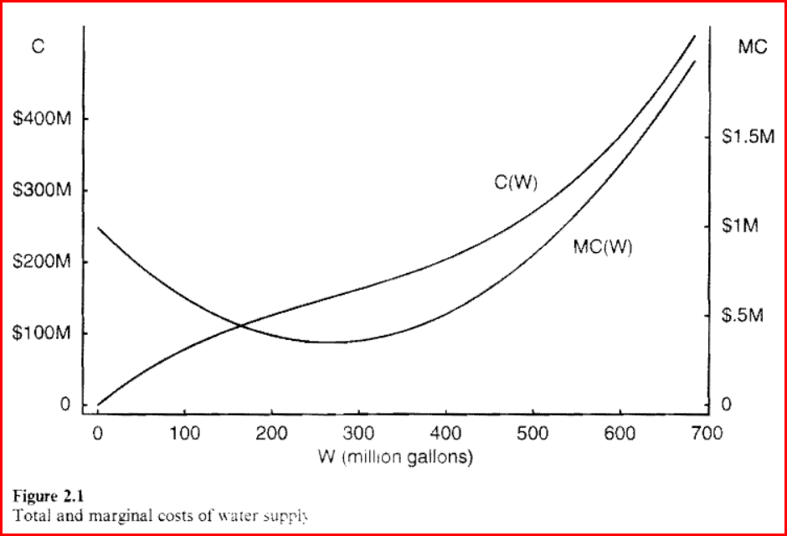
Economies of Scale

Slide 52
Hidden Benefits
Changes in land values
Undeveloped land
Developed land
Rents to be made via government contracts
Politicians/bureaucrats
Firms/individuals
Secondary outputs (e.g., electricity, flood control)
Easy to net out
Ignored here but may be important in actual decisions

Slide 53
Uncertainty Everywhere
Vast literature in engineering/hydrology/economics on modeling stochastic component
Roseta-Palma and Xepapadeas “Robust Control in Water Management” (JRU, 2004) look at case where there is uncertainty over
PDF’s of the random variables
Correct specification of supply/demand functions

Slide 54
Dupont and Renzetti (ERE, 2001)
Surprisingly little work done by economist on industrial water demand
In part a response to the low cost/high reliability of water supply in most industrial countries
Usually a small part of cost and always available
Aside: situation often quite different in developing countries and increasing amount of work being done on topic
Data availability/huge water withdrawals by power generation
Expenditures on water in a firm fall into three categories:
Intake
Recirculation
Discharge

Slide 55
Modeling Issues
Data Sources
Combine multiple data sources for three years 1981, 1986, 1991
Industrial Water Use Survey (Environment Canada)
Survey of Municipal Water Pricing
Various Statistics Canada manufacturing data bases
Create a two digit SIC code at provincial level
Take standard KLEM (capital, labor, energy, materials) model
Add two water variables (water intake, water recirculation)
Look at specifications that differ by what factors considered (quasi-) fixed and variable cost
Translog cost equation/shares
Second order approximation/system of equations

Slide 56
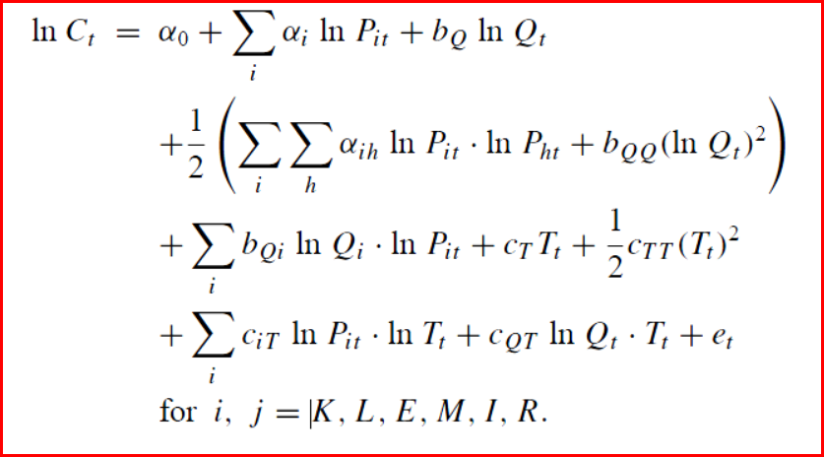
Translog Cost Function plus share equations

Slide 57
Results
Intake water should be treated as a variable input
Estimates for 45 parameters/R-square = .89
Output elasticities [.69 for intake water, .72 recirculation]
Pattern of intake and recirculation elasticities different
Weak substitutes for each other
Intake substitute for labor/recirculation substitute for materials
Intake complement to capital/recirculation substitue
Elasticity of technological change w.r.t. cost -.30
Shift toward water intake and away from recirculation
Limited analysis suggests some differences if allow differences between cooling/steam generation and process water use

Slide 58
Olmstead, Hanemann and Stavins (2007)
What is the price elasticity of residential water demand?
Difficult question to answer/critical to many questions
Ability to reduce water use through price
Desirability of many conservation measures
Desirability of many large scale infrastructure investments
Why is it hard?
Nature of price variation
Lack of knowledge about cost of water
Residential water pricing regimes fall into four types:
No meters, decreasing block structure, flat rate, increasing block structure
Difficult to learn much from first two

Slide 59
Residential Water Pricing Regimes
Fall into four types:
No meters: can only learn unconstrained demand
Decreasing block pricing: usually put into place to encourage water use to help pay for system/opposite structure to reduce
Flat rate: little information if fixed & communities ideosyncratic
Increasing block pricing: most information but has “kinks”
Price
Water Quantity

Slide 60
Increasing Block Pricing (IBP)
Increasingly popular with water systems
Up from 4% of systems to about 1/3 in 2000
Attempt to provide incentives to conserve water
Ideal is cost of last block equal long term marginal cost
Provides a way to shift cost allocation in system
Higher prices for later blocks allow lower prices for earlier blocks (lifeline concept/less regressive)
Typically small number of blocks (2, 3, or 4)
Makes econometric estimation of price elasticity difficult
Block structure makes budget constraint piece-wise linear
Problem first addressed (Burtless/Hausman, 1978) in context of labor supply/now common issue in public economics
Potential endogeneity in using IBP/choice of blocks & prices

Slide 61
Residential Water Elasticity Estimates
From meta-analyses
Epsey, Espey, Shaw (WRR, 1997) using 124 U.S. studies
Short run mean -0.51, median -0.38; long run median -0.64
Dalhuisen et al. (Land Econ, 2003) using 300 studies
Mean short run price elasticity -.041
Typical study uses log-log demand function
ln(w) = αln(p) + γln(Income) + δZ + η + ε
Z is other observable characteristics of household
η represents unobserved household hetrogeneity
ε represents errors in optimization
Without IBP estimation straightforward. Tedious with
Endogeneity may still be a problem

Slide 62
Empirical Estimation
1082 households in 11 urban areas/16 water companies
Survey sponsored by American Waterworks Foundation
Daily information collected for two two periods: wet/arid
Price, consumption, household characteristics
40% of households within 5% of kink point
Elasticities estimates
Price (IBP households): -0.59 Income: 0.18
Price (uniform pricing): -0.33 Income: 0.04
Indications that price structure influences elasticities

Slide 63
Water Reliability
Key question: what are households WTP to avoid having to ration water
Key difficult: without price variation no reliable information available from observed water use
Two approaches around problem
Damage approach: calculate damages that would occur from water rationing (e.g., dead plants)
Can under/overstate WTP
Create missing market in a contingent valuation survey
First done in study by Carson in mid 1980’s
Used for water policy by MWD
Widely copied

Slide 64
Structure of Contingent Valuation Survey
Introductory section
Sponsor of study
Purpose and context of study
Detailed description
Good
How it would be provided
Valuation question(s)
Information about respondent

Slide 65
Water Reliability in California Cities
Valuation question:
If the plan to reduce the threat of water shortages is implemented your household water bill would increase $X per month. Do you want the water agency to implement the plan?
YES or NO
$X randomly varied across respondents
Household questions:
water use (inside and outside)
awareness of shortage issues
demographics

Slide 66
Households (equivalent random samples) can be asked about different water shortage scenarios:
$83 WTP to avoid a 10% to 15% water shortage once every five years
$114 to avoid a 30% to 35% water shortage once ever five years
$152 to avoid two 10% to 15% water shortages every five years
$258 to avoid one 10% to 15% water shortage and one 30% to 35% water shortage.

Slide 67
Policy Uses
Helped provide a different and consistent way to look at policy decisions regarding the water system as a whole
Helped provide information on the value of reducing uncertainty over likely shortage scenarios
Set an upper bound on the value of possible ways to improve reliability
Translated into a maximum WTP per acre foot of water obtained (conservation/new sources)
Difference between this amount and what water agency paid is the gain to the public

