Slide 1
Property Rights, Water Markets & California Water Policy
Professor Richard T. Carson
Department of Economics
University of California, San Diego

Slide 2
Water Grab Game
River

Slide 3
Water Grab Game No Conflict: 1 Farm
Farm
River

Slide 4
Water Grab Game How to Split the Water?
Options: (a) equally, (b) seniority (Farm 1), (c) position on river (Farm 2), (d) proportionate to river frontage or (e) land area, (f) political power
Farm 1
River
Farm 2

Slide 5
How to Split the Water? Temporal Issues
River flow is has little variability
Original division rule may work with little modification
River flow has substantial variability
May induce use of a different rule for low flows than original division
Priority to seniority [implicit infrastructure investment]
Priority to highest valued use
Number of people
Type of agricultural production
Are there opportunities to trade water?

Slide 6
Water Grab Game How to Treat Subsequent Entrants
Options: (a) equally, (b) seniority, (c) position on river, (d) river frontage, (d) land area, (e) political power
Farm 1
River
Farm 2 Farm 3

Slide 7
Water Grab Game How to Treat Entrants Without River Frontage
Options: (a) no rights, (b) purchase water from Farm 2 or 3, or (c) extract from directly from river and transport to Farm 4
Farm 1
River
Farm 2 Farm 4 Farm 3

Slide 8
Surface Water Property Right Typology
Riparian (English in origin)
Water rights based on ownership of land bordering water body
Many variants
Amount of river frontage
Position on river (e.g., more senior rights upstream)
State Ownership (Spanish in origin)
Often temporarily allocated and then shared
Sometime formally given away with conditions
In some cases, use without complaint for a sufficiently long period conveyed private ownership rights
Prior appropriation
First use, associated with mining in western U.S.
Right to specific quantity with use it or lose it conditions
Sometimes transferable as long as “beneficial” use

Slide 9
What about water for ecosystems?
Usually ill-defined in riparian systems
Later times, diminished downstream quality sometimes invoked as constraint
State ownership and ability to allocate
Government decides
Prior appropriation
Usually no constraint
Current situation hybrid of all three types of water rights

Slide 10
Ground Water Property Right Typology
Absolute Ownership/Common Law
Water beneath one’s land is the property of the landowner and may be withdrawn without regard to the impact on any other landowner
American Rule (western U.S.)
Withdrawal rights limited to “beneficial” uses which are typically defined as not taking the water off the land
Correlative Rights (California)
Recognizes that multiple landowners may over lay a groundwater aquifer. Reasonable beneficial use with equal (proportionate) shares
Prior appropriation
Sequence of who pumps and what rate. Differences by aquifer seen as depleting over time versus safe-yield if recharging fast enough.

Slide 11
Standard Economic Story Line
Tragedy of the Commons
New agents enter to exploit the natural resource until the marginal (short run) value of doing so is zero
Drives down profits of all users
Equivalent to having a infinite discount rate for the future
Clear early model put forth by Scott Gordon (“Economic Properties of a Common Property Resource: The Fishery,” JPE, 1954)
Popularized in the science/ecology literature by Garrett Hardin (“Tragedy of the Common,” Science, 1968)
Population growth key force in driving problem
Solution requires either state control or full privatization

Slide 12
State Owned Solution
History of high level state claims to all water resources
Goes back to beginning of recorded time
Main precedent for U.S. claims by Spanish crown for much of the Southwest
Typically very incompletely enforced
Recognition that localized control necessary for well functioning society
State control implies
Ability to reward (temporarily) particular agents
Modern attempts environmentally disasterous
Soviet Union

Slide 13
Usual Economic Recommendation
Fully delineate complete property rights to water
Rights incorporate stochastic nature of flows
Make those rights fully transferable/tradeable
Institutions to exchange, monitor/enforce transactions needed
If water is deemed to be publically owned:
Auction off rights so that public gains full resource rent
Auction off either permanently or with long lease to ensure adequate infrastructure investment
If water is needed for ecosystem support determine optimal quantity in different contexts and alter quantity/nature of water rights auctioned to agents
If supply of water to households/firms is deemed to have elements of a natural monopoly then
Regulate as a monopoly
Equity concerns might suggest “lifeline” block for small usage

Slide 14
Early Comprehensive Econ View of Water
Water Supply: Economics, Technology and Policy
Hirshleifer, De Haven, Milliman (U. Chicago Press, 1960)
Study funded internally by Rand
Built on earlier work by
Gordon and Scott work on commons/fisheries
Green book (Congressional subcommittee on Federal projects, 1950/1958)
Harvard Water project (Eckstein, Krutilla and others)
McKean (Efficiency in Government through Systems Analysis, Wiley, 1958)
Reaction against major Federal efforts/reports on water
Reaction against big California & New York water projects

Slide 15
“Many of the conclusions of the book are likely to be controversial. This is so because these conclusions are often at variance with present practice governing existing water supplies.”

Slide 16
Conclusions/Recomendations
Complete rejection of “water-is-different philosophy”
Water does have a number of characteristics which make it an interesting/difficult good to develop appropriate policies for
Water misallocation across sectors
Water mispriced within sectors
Confusion over average versus marginal cost
Large amounts of cross-subsidization
Benefit/cost estimation
Dubious benefits (e.g., employment) included
Environmental harm not included
Lowest cost supply frequently not used
Inappropriately low discount rates used

Slide 17
Communal Control Story Line
People at the local community level develop informal rules/social norms which solve or substantially mitigate commons problem
Argument most closely associated with
Elinor Ostrom (Governing the Commons: The Evolution of Collective Action, Cambridge University Press, 1990)
Richard Norgaard (Development Betrayed, Routledge, 1994)
Ostrom, Burger, Rield, Norgaard, Policansky (“Revisiting the Commons: Local Lessons, Global Challenges, Science, 1999)

Slide 18
Five Basic Insights
In addition to open access, government control and individual property rights there are group/community rights
Lots of successful empirical examples of communities overcoming commons issues around the world
Historical custom/social norms play a large role
Success stories usually from small homogenous groups
Success stories usual involve some way of controlling:
New entrants
Free riding with respect to maintenance

Slide 19
Game Theoretic Underpinnings
Gordon/Hardin framework essential a prisoner’s dilemma
No ability to make binding commitments with respect to:
New entrants
Future actions
Early work in experimental economics show various ways out of the prisoner’s dilemma with repeated play
People more altruistic than pure self-interested assumption
Cooperation if started often continues
Axelrod’s tit-for-tat play typically won contests
Weak sanctions often encourage/sustain cooperation
Coase flavor whereby group membership serves to reduce transactions cost and hence bargaining tends toward an efficient allocation

Slide 20
Where Does Communal Model Breakdown?
Group size becomes large
Little power over new entrants
Cannot deter entry
Cannot extract side payments to join group
Unable to impose sanctions on members not contributing “fair” share of maintenance activities
Amount of use by group members not easily observed
Stochastic aspects of resource not well understood
Group decision rule on allocation lacks:
Transparency
Perceived fairness
Efficiency (economic)

Slide 21
World Bank View Water in Developing Countries
Water problems are serious in many countries
Water is badly misallocated in many instances
Poor households disproportionately and adversely impacted by current water policies
Economic efficiency/equity tradeoffs often poorly thought out
Standard criteria for allocating water inherently contradictory

Slide 22
Criteria for Allocating Water Dinar, Rosegrant, & Meinzen-Dick (1997)
Flexibility to meet changing demand
Security of tenure for established users
Real opportunity cost (including environmental externalities) paid by users
Predictability of allocation process
Minimization of transactions cost
Perceived equity of allocation process
Political/public acceptability
Effective at moving system toward desire objectives
Administrative feasibility/sustainability

Slide 23
Standard List of Allocation Options
Marginal cost pricing
Advantage: economically efficient outcome
Disadvantage: difficult to measure, not constant across time, equity issues
Public/Administrative Allocation
Advantage: political acceptability
Disadvantages: most costly, lack of incentives to conserve, subsidization of large scale projects (irrigation)
Water Markets
Advantage: efficient use and allocation across sectors, encourages appropriate infrastructure investment
Disadvantage: difficulties of implementing with stochastic flows & externalities, opposition from those with current implicit/explicit rights
User Based Allocations
Advantage: flexibility in meeting local needs/changing situations
Disadvantage: requires some form of reasonably strong implicit/explicit community property rights, unable to deal with cross sector allocation issues

Slide 24
Rosegrant and Binswanger (1994)
“What water policies can lead to efficient increases in irrigation production while reducing resource degradation in the irrigated areas in developing countries releasing water for growing nonagricultural demands?
Policies employed fall into four categories:
Technological solutions
Public management of irrigation systems
Communal management
Tradable water rights
Only the first three have been extensively employed

Slide 25
Two questions
Have the first three approaches worked?
Why have tradable water rights not worked?

Slide 26
Technological solutions
Tend to be large infrastructure projects
Popular with politicians
Look like bad investments from World Bank’s perspective
Bottom line: rent seeking and subsidization
Public management of irrigation systems
Mixed results
Some pricing reforms and improvement of worst cases
But generally run in fairly inefficient and often arbitrary way

Slide 27
Communal water management
Farmer/community management is popular idea at World Bank
Communal management no worse than public management and often facilitates resolution of local conflicts
No indication communal management results in
Increased farm production
Increased farm income
Improved access to water
Clear demarcation of duties between community and government
Greater ability to solve conflicts across communities

Slide 28
Water Markets
Usual economic view is that water markets are substitutes for the other three approaches
Rosegrant and Binswanger/Dinar et al. argument that they may be complements:
More costly water improves conservation and secure property rights should result in better technology choices
With government out of many routine pricing decisions can focus on rules of the game for trades and reducing transactions costs
Communities can be given/buy water rights. Trade sets the price of buying/selling water and allows decisions to be made which benefit the community rather than zero sum game

Slide 29
Forces working against use of water markets
Price of water is too low (government subsidies are high)
Usual some group/class of agents with implicit rights who will lose under formal water markets
Engage in considerable rent seeking to block
Resolvable by giving rights to current users but at public’s expense
Fear water will get transferred out of agriculture to cities
Adverse secondary impacts on agricultural areas
High cost/insecure transactions
Difficulties defining/measuring water use
Variability in the water supply
Two approaches:
Proportionate to stream flow
Seniority in taking specified volumes
Treatment of return flows
Examples of use of water markets while limited are expanding around the world: Chile, India, Mexico, Pakistan

Slide 30
Adams, Rausser & Simon (JEBO, 1996) Modeling Multilateral Negotiations An Application to California Water Policy
Try to capture key features of large messy policy negotiations between interested parties
Key feature 1: regulator can impose solution if parties do not agree. Solution may be undesirable to all.
Key feature 2: multiple parties
Key feature 3: policy is multidimensional
Key feature 4: negotiations are multi-period
Key feature 5: parties agree on ground rules for talks
Key feature 6: some parties have more influence
Key feature 7: each party represents larger set of members

Slide 31
Three parties
Agricultural water districts/irrigators
Urban water districts/consumers/industry
Environmental groups
Agriculture
Strongly oppose water for environment
Wants more infrastructure
Weakly oppose water markets
Urban
Strongly favors water markets
Wants more infrastructure
Weakly opposes water for the environment
Environmentalists
Strongly favors water for the environment
Opposes infrastructure
Weakly opposes water markets

Slide 32
Analysis Plan
Objective: look at how features of the game influence outcomes using simulation
Set-up
Define utility function/parameters
Define negotiating range/parameters
Define outside solution/parameters
Vary key parameters

Slide 33
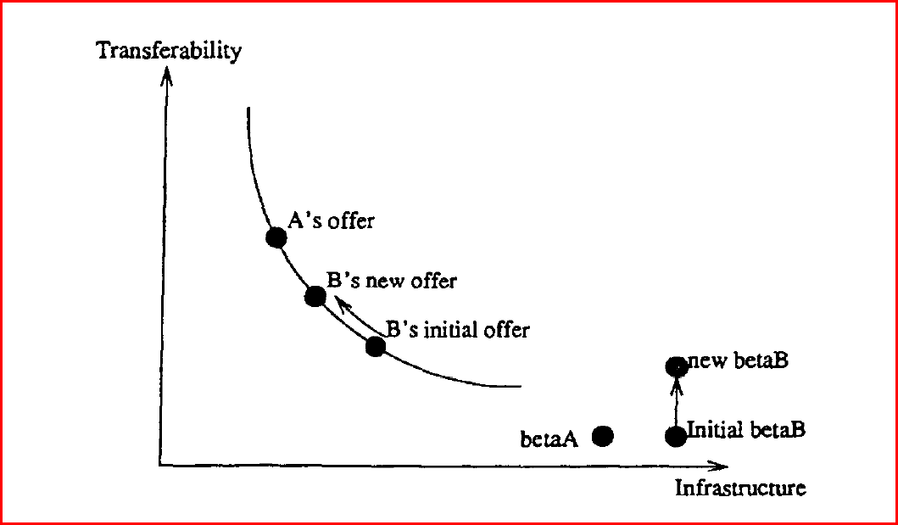

Slide 34
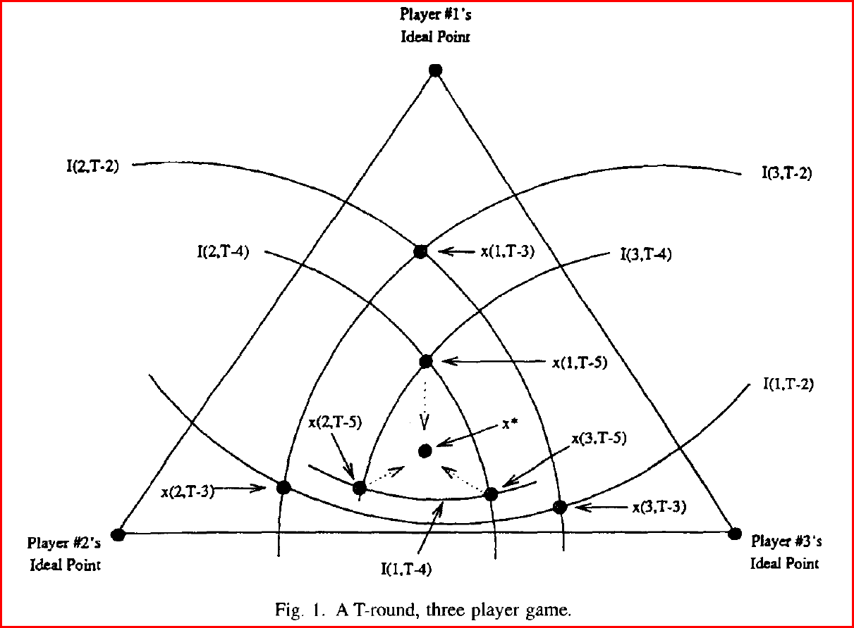

Slide 35
Basic Results
Expanding the negotiating space can
Make agreement more likely
Lower or raise utility of all actors
Shifting the disagreement point toward one actor’s ideal point strengthen their bargaining power
Heterogeneity in a party’s members positions weakens that party’s bargaining power if they can defect.
Ability of party to make proposals and their sequence can be important
Agreement often possible

Slide 36
Murphy, Dinar, Howitt, Rassenti & Smith Design of ‘Smart’ Water Market Institutions Using Laboratory Experiments (ERE, 2000)
Use the smart market concept of McCabe, Rassenti and Smith (Science, 1991)
Computer solves for outcome given participant input
Technological constraints and information availability important
Uniform double price auction provides market clearing price.
Ability to query for information/prices up to time market closes
Computer coordinates flow of water given submitted bids and maximizes total gain (without regard to agent identities) given those bids

Slide 37
Three types of agents
Water buyers
Water sellers
Water transporters
Agents stylized representations of actual California water districts (e.g., San Diego)
Four agricultural water districts
Three with access to groundwater
Five urban water districts
Different representations of water conveyors
Monopoly versus competitive

Slide 38
Moving Parts
Consumption of water
Agriculture
Urban
Supply of water
Surface water (stochastic supply)
Groundwater
Transportation of water
Constraints on environmental flows
Cost of conveying water

Slide 39
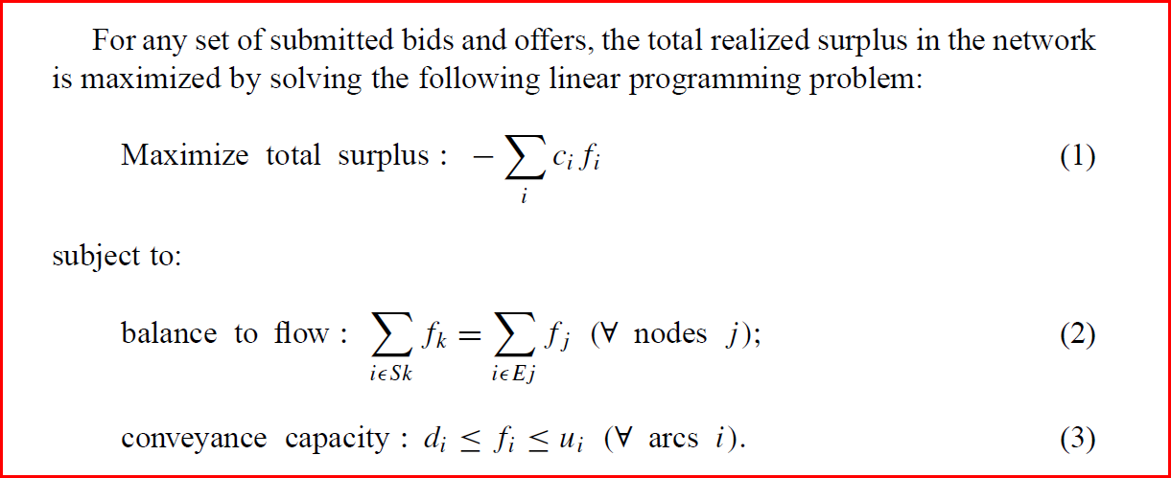
Core of How Water Markets Work

Slide 40
Results
Based on repeated trials under different conditions over a two day intensive session with same group of University of Arizona undergraduates
Market is thin
Outcomes often strongly influenced by aberrant behavior by one agent
Profit maximizing opportunities often missed
Substantial variability in responses
Substantial market power
System slow to respond to variability in supply
Average efficiency relatively high in spite of these problems
Gains from trade sizeable

Slide 41
Critics Stylized View of World Bank Induced Water Disaster
Communal management with village water tank
World Bank comes in (India/Pakistan)
Provides loans for shallow tube wells
Farmers/households put in such wells
People don’t have to go substantial distances for water
Agricultural yields go up
Village tank falls into disrepair
Tube wells start going dry after a few years
Community starts to fall apart

Slide 42
The (Nine) Principles of Water Democracy Vandana Shiva (South End Press, 2002) Water Wars: Privatization, Pollution & Profit
1. Water is nature’s gift
We receive water freely to nature. We owe it to nature to use this given in accordance with our sustenance needs, to keep it clean and inadequate quantity. Diversions that create arid or water logged regions violate the principles of ecological democracy.
2. Water is essential to life
Water is the source of life for all species. All species and ecosystems have a right to their share of water on the planet

Slide 43
3. Life is interconnected through water
Water connects all beings and all parts of the planet through the water cycle. We all have a duty to ensure that our actions do not cause harm to other species and other people.
4. Water must be free for sustenance needs
Since nature gives water to us free of cost, buying and selling it for profit violates our inherent right to nature’s gift and denies the poor of their human rights.
5. Water is limited and can be exhausted
Water is limited and exhaustible if used nonsustainably. Nonsustainable use includes extracting more water from ecosystems than nature can recharge (ecological nonsustainability) and consuming more than one’s legimate share, given the rights of others to a fair share (social nonsustainability).

Slide 44
6. Water must be conserved
Everyone has a duty to conserve water and use water sustainably, within ecological and just limits.
7. Water is a commons
Water is not a human invention. It cannot be bound and has no boundaries. It is by nature a commons. It cannot be owned as a private property and sold as a commodity.
8. No one holds a right to destroy
No one has a right to overuse, abuse, waste, or pollute water systems. Tradeable-pollution permits violate the principle of sustainable and just use.
9. Water cannot be substituted
Water is intrinsically different from other resources and products. It cannot be treated as a commodity.

Slide 45
California and Water
History
Some current facts
Current policy issues

Slide 46
History The Long View
Good Source: Norris Hundley (2001) The Great Thirst: Californians and Water History (University of California Press)
Indian (Pre-Spanish)
California support sizeable population (300,000)
Most of the population lived in the interior along the large rivers.
Largely existed on fishing (salmon, steelhead) & hunting
Irrigation developed in Owens Valley & along Colorado
No influence on current water situation

Slide 47
Spanish
Settle along the coast where settlements could be supplied by ship
Used a combination of religion (missions) and military
Initial settlements on good harbors & fresh water supply
San Diego (1769), Monterrey (1770), San Francisco (1777), Santa Barbara (1782)
Other missions and settlements (pueblos) fill in:
San Jose (1777), Los Angeles (1781)
Spanish Crown asserts total control of water
Land/water though said to be“held” in trust for Indians

Slide 48
Spain and California similar
Arid
Water supply variable
Spanish water customs/law applied to both
Crown grants settlements “temporary” water rights
Many settlements have substantial problems/failure
Water shortages
Agricultural production issues
Custom is proportionate sharing of water
Including shared responsibility to maintain system
Issues arise in sharing water/other provisions across missions and pueblos
Formal procedures for designated Royal official to adjudicate water (and related land boundary) conflicts
Often slow

Slide 49
Water problems expand
Settlements along coast grow taxing water supplies at some times of the year
Spanish Crown desires settlements in interior
Conflicts with damming upstream water supplies
Develops into a system of “senior” do no harm rights
Spanish Crown desires to give away large land parcels for ranchos
Water on land usable for livestock & domestic purposes
Could petition to irrigate limited (10%) amount of land
Property rights could be obtained if water used for some purpose, typically irrigation, for 10 years and no complaints lodged with authorities
This custom influences later western U.S. water law

Slide 50
Spanish water law impacts western United States via
Custom
1848 Treaty of Guadalupe Hidalgo ending war with Mexico
Most important case was Los Angeles assertion of “pueblo water rights” claiming water from the Los Angeles river
California’s Indian population had declined by 50% (to 150,000) during Spanish/Mexican rule. Declined to 20,000 by 1900 under American rule.
California non-Indian population booms from 10,000 in 1846 to 100,000 in 1849 to 1.5 million in 1900.

Slide 51
Huge population jump soon after U.S. takes control of California due to discovery of gold in 1848.
The need for water for gold mining drives practice on the ground:
Gold largely on public land
Often not on a river but within a few miles
Preemption Act of 1841 recognized rights of first settlers to buy government land later at lowest price
Strong informal custom of first settlers to support each other over new entrants
Claims to use water only good as if mining still being undertaken
Claims enforced by informal miner’s courts
Federal/California government do not step in

Slide 52
First in time/first in right custom/implicit right develops
Recognized in law in California in 1851 as prior appropriation and by Federal government (who owned much of the land) in 1866
Clear conflict with riparian water rights recognized by California in 1850 and long the basis of most Federal and state water law
Appropriative water rights recognized now in all western U.S. states
Similar to Spanish water law in emphasis on use but under Spanish water law initiative for assign water rights lay with Crown. In U.S. emphasis on actions of individuals.
Initially only miners could take water but California court in 1855 upholds appropriative right to take water to sell to miners and creates a water industry.
Practice of “hydraulic mining” using water pressure to move dirt and rocks to expose gold develops
Immensely profitable and environmentally destructive
Shut down in 1884 by U.S. 9th Circuit Appeals Court decision on the basis of damaging property of others and impairing navigation
One of the earliest major environmental decisions by a U.S. court

Slide 53
Riparian and prior appropriation water law eventually class in California as a few people amass huge quantities of land in Central Valley
Small number of people had filed for appropriative rights much larger than total flows
Small number of people controlled much of riparian rights
In 1886 California Supreme Court (Lux v. Haggin) that:
Riparian rights inherit in all private lands, including public lands when they passed into private ownership
An appropriator could posses superior rights to a riparian if appropriator began taking water before riparian acquired property

Slide 54
Small farmers/land owners react against water grab by big land owners by urging California to set up irrigation districts.
California pass the Wright Act 1887
Allowed for public irrigation districts
Locally controlled
Could take water under fairly loose conditions
Could tax land owners for district
Encouraged a large increase in irrigated agriculture
Subject of lots of litigation with big land owners

Slide 55
Big Projects

Slide 56
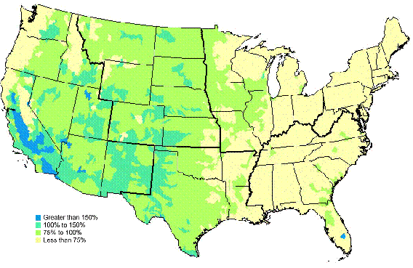
Water Consumption as Percent of Average Annual Precipitation

Slide 58
California’s Ground Water
California’s groundwater basins store about 850 million acre-feet of water.
Less than 50% is unavailable for use due to depth of water table.
Legally groundwater cannot be removed if not replenishable.
15 million acre-feet of groundwater is pumped each year.
20% of the state’s water requirements met with groundwater.
More in dry years
On average CA is operating on a 1.3 million acre-foot overdraft.
CA groundwater is recharged by:
1) Nature – rain & snow (7 million acre-foot annually)
2) After usage – agriculture & industry (6.65 million acre-feet annually)
3) Recharge programs

Slide 59
The Standard Conflicts
North versus South
80% comes from North of Sacramento
80% used South of Sacramento
Interesting role of San Francisco in North-South debate
East versus West
Even larger share originates on eastern mountains and used to west on coast or Central Valley
Agriculture versus Urban
Traditional
Environmentalists versus Agriculture & Urban
Federal/California courts uphold Public Trust Doctrine mid 80’s

